Slide 1
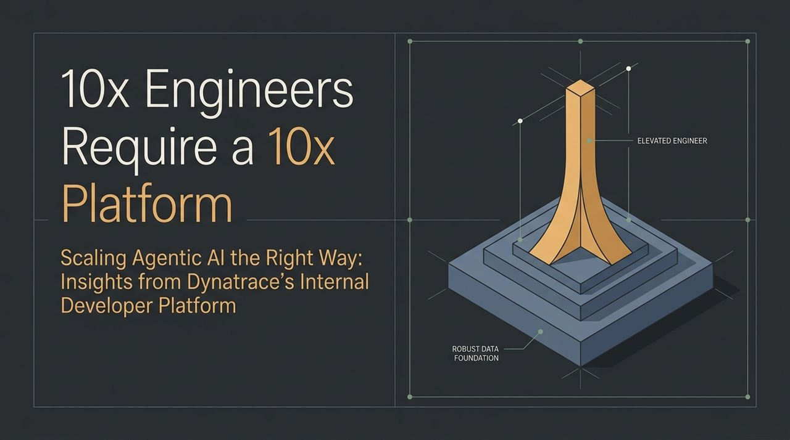
Notes:
Welcome, everyone. Today, we’re going to discuss how to scale AI agents within engineering organizations effectively—without falling into common traps that plague modern software teams.
There is a massive industry shift happening right now: organizations are rushing to equip developers with generative AI coding tools, assuming that giving a '10x engineer' an AI assistant will automatically yield 10x output.
However, what we’ve discovered through our internal development journey at Dynatrace is that elite engineers equipped with high-powered AI tools cannot scale effectively if they are forced to deploy onto broken, fragmented infrastructure.
To genuinely scale agentic engineering across 2,000+ developers, you must build a 10x Internal Developer Platform (IDP) anchored on a Robust Data Foundation that elevates the engineer from tactical repetitive coding to high-value architectural oversight.
https://www.youtube.com/watch?v=3jT_iUHvf_M

Slide 2
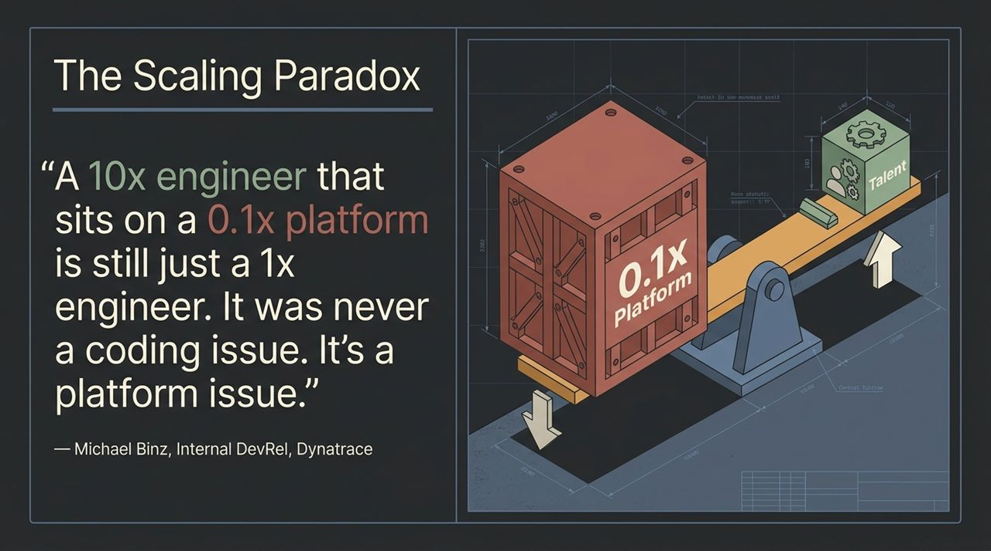
Notes:
Let’s start with a reality check that defines our entire engineering philosophy: A 10x engineer sitting on a 0.1x platform is still just a 1x engineer.
When AI coding assistants were first introduced, the initial reaction across many teams was, 'How can we use AI to write code faster?'
Writing raw code is rarely the primary bottleneck in enterprise software development. The real friction lies in everything surrounding the code: provisioned environments, CI/CD pipelines, compliance checks, security policies, and fragmented cloud tech.
If an AI agent generates a pull request in 30 seconds, but it takes three days for the team to navigate internal red tape, figure out deployment configurations, and manually fix broken pipelines, you haven't accelerated delivery—you've simply amplified the queue.

Slide 3
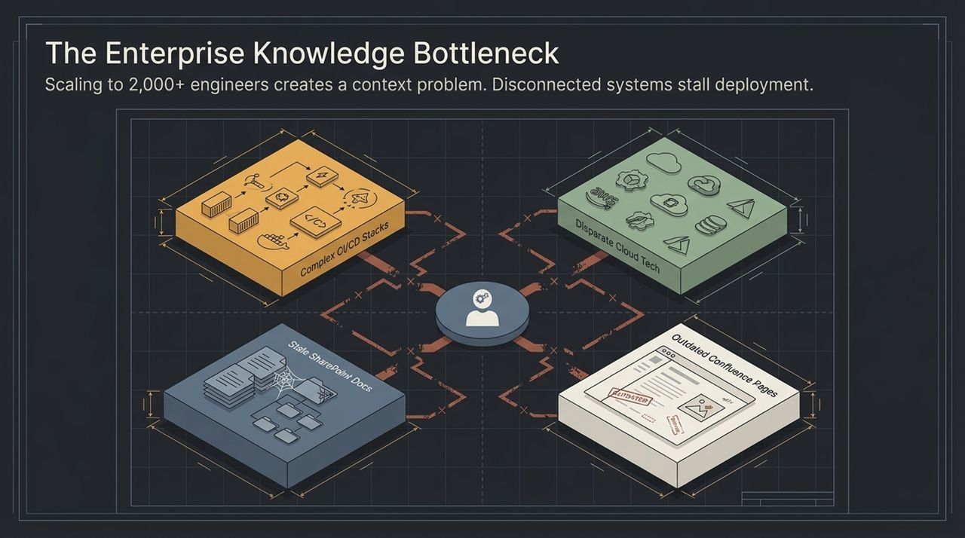
Notes:
As organizations grow to 2,000+ engineers, the primary operational challenge becomes a knowledge and context problem.
Engineers are continuously bombarded with fragmented sources of information: complex CI/CD stacks, disparate multi-cloud configurations, stale SharePoint documents, and outdated Confluence pages that haven't been updated in years.
Historically, platform engineering attempted to solve this by building user interfaces (UIs) or written runbooks to abstract this complexity away.
However, human engineers spend an enormous amount of time searching across these disconnected systems just to figure out simple things—like who owns a service, which API to invoke, or what quality gates are required for production.
When you introduce AI agents into this chaotic environment without structured knowledge, the agents fail for the exact same reasons humans do: lack of accurate, up-to-date context.

Slide 4
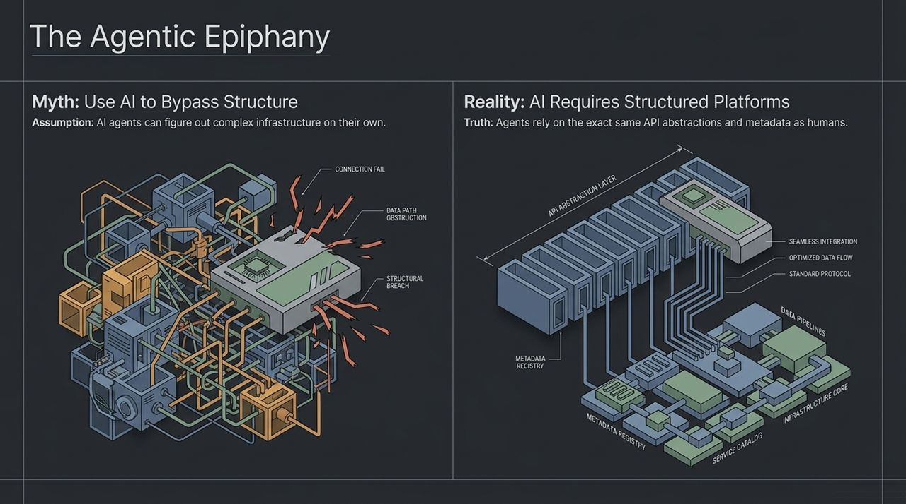
Notes:
This brings us to a major epiphany we had when scaling agentic workflows.
Early on, there was a widespread myth: 'Since AI agents are intelligent, we can bypass complex platform structures and let agents figure out infrastructure, environments, and raw Kubernetes natively on their own'.
That assumption leads directly to structural breaches, connection failures, and data path obstructions.
The reality is that AI agents do not possess magical intuition. In fact, AI agents rely on the exact same clear API abstractions, metadata registries, service catalogs, and standard protocols that human developers need.
Agents require structured, deterministic platforms to function safely and reliably. Rather than replacing the platform, agentic AI makes a well-architected platform more essential than ever before.

Slide 5
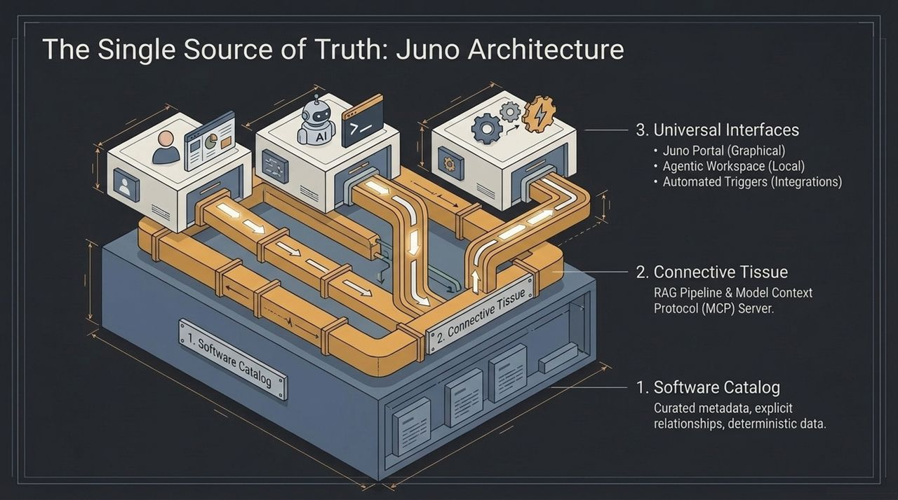
Notes:
To solve this knowledge and abstraction problem at Dynatrace, we engineered Juno, our internal developer platform.
Juno is structured into three foundational layers:
The Software Catalog (Foundation): Curated, highly structured metadata defining software components, explicit ownership, dependencies, and deterministic operational data.
The Connective Tissue: A dedicated Retrieval-Augmented Generation (RAG) pipeline combined with a Model Context Protocol (MCP) Server. This acts as the bridge, ensuring both human developers and AI agents query the exact same grounded context.
Universal Interfaces: Flexible access points catering to different modes of work—the Juno Portal for visual exploration, the Agentic Workspace for local development, and Automated Triggers integrated into GitHub pull requests and CI/CD pipelines.
Because the catalog provides explicit relationships rather than probabilistic guesses, AI agents hooked into Juno receive verified context, eliminating hallucinations.

Slide 6
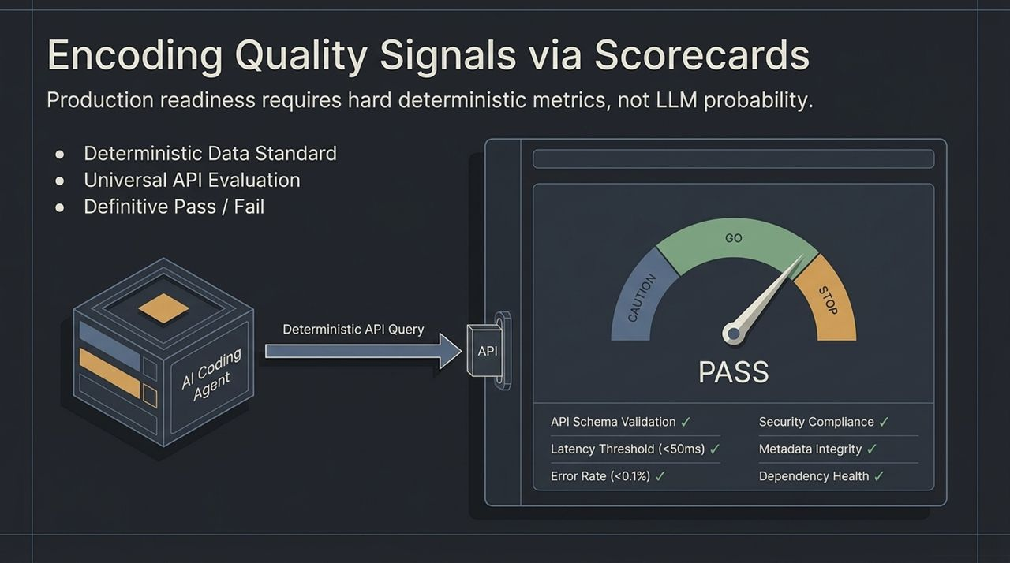
Notes:
One of the most critical principles in an agentic platform is enforcing a clear boundary: Never use probabilistic LLM evaluations to gate production releases.
Production readiness must be governed by hard, deterministic metrics.
In Juno, we encoded our engineering standards into automated Scorecards. When an AI coding agent or a human engineer prepares a deployment, the system executes a deterministic API query to evaluate quality signals against strictly defined parameters:
API Schema Validation
Latency Thresholds (<50ms) & Error Rates (<0.1%)
Security Compliance & Dependency Health
Metadata Integrity
This creates a definitive Pass/Fail gate. The agent can use the scorecard feedback loop to fix bugs autonomously before requesting human review.

Slide 7
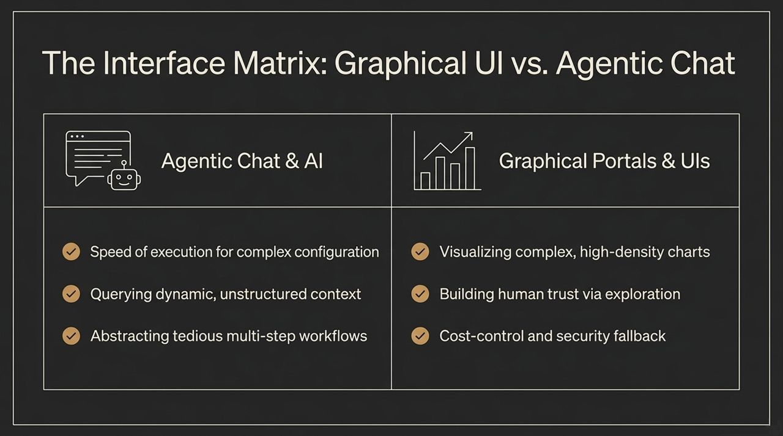
Notes:
As we expanded Juno, we examined the interplay between Graphical UIs and Agentic Chat.
Agentic Chat excels at execution speed, multi-step workflow abstraction, and querying dynamic context. However, Graphical UIs remain essential for high-density visual data (charts, telemetry) and building human trust through intuitive exploration.
To handle internal innovation without creating chaos, we established the Skill Marketplace Lifecycle:
Open Contribution: Engineers created over 200 raw internal skills/tools for their agents.
Curation Filter: Platform teams deduplicate, run standard checks, and review submitted capabilities.
Official Ecosystem: Vetted, high-quality skills are promoted to official Juno Platform Assets, accessible across the organization.

Slide 8
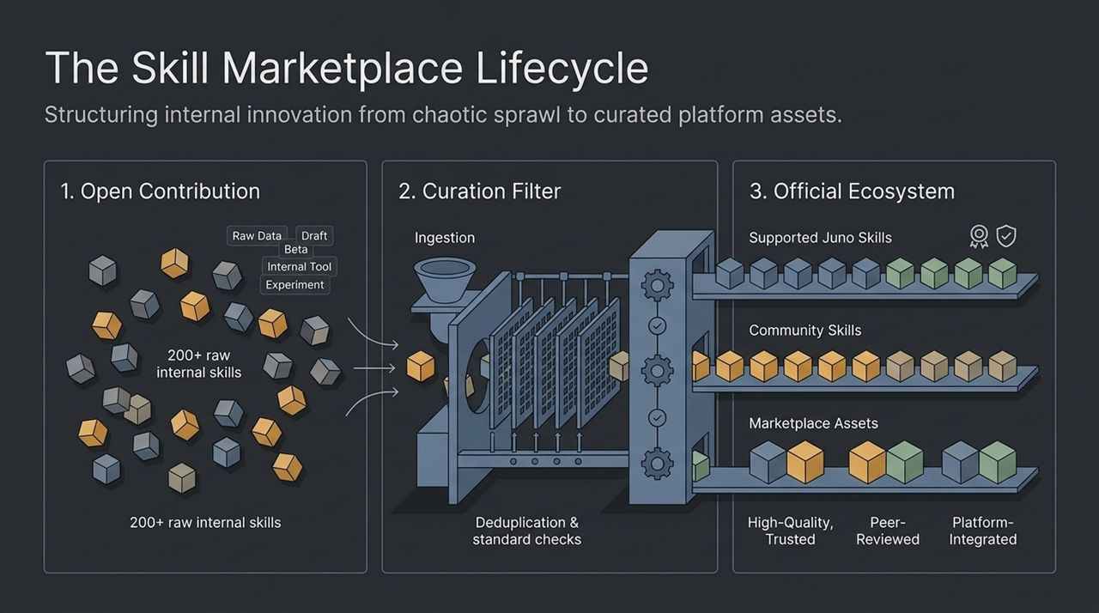
Notes:
If you cannot measure your agentic ecosystem, you cannot manage or justify it. We leveraged OpenTelemetry to instrument every single agentic interaction.
We track three major dimensions:
User Adoption: Monitoring active adoption trends scaling toward our full 2,000+ R&D engineering organization.
Agentic Telemetry: Capturing prompt inputs, context retrieval latency, LLM model execution, tool invocation, and token logging.
Business Impact & DORA Metrics: Demonstrating tangible ROI. As shown in our deployment data, average deployment times dropped from 60 minutes pre-agentic, down to 30 minutes in pilot, and ultimately to 10 minutes upon full rollout.

Slide 9
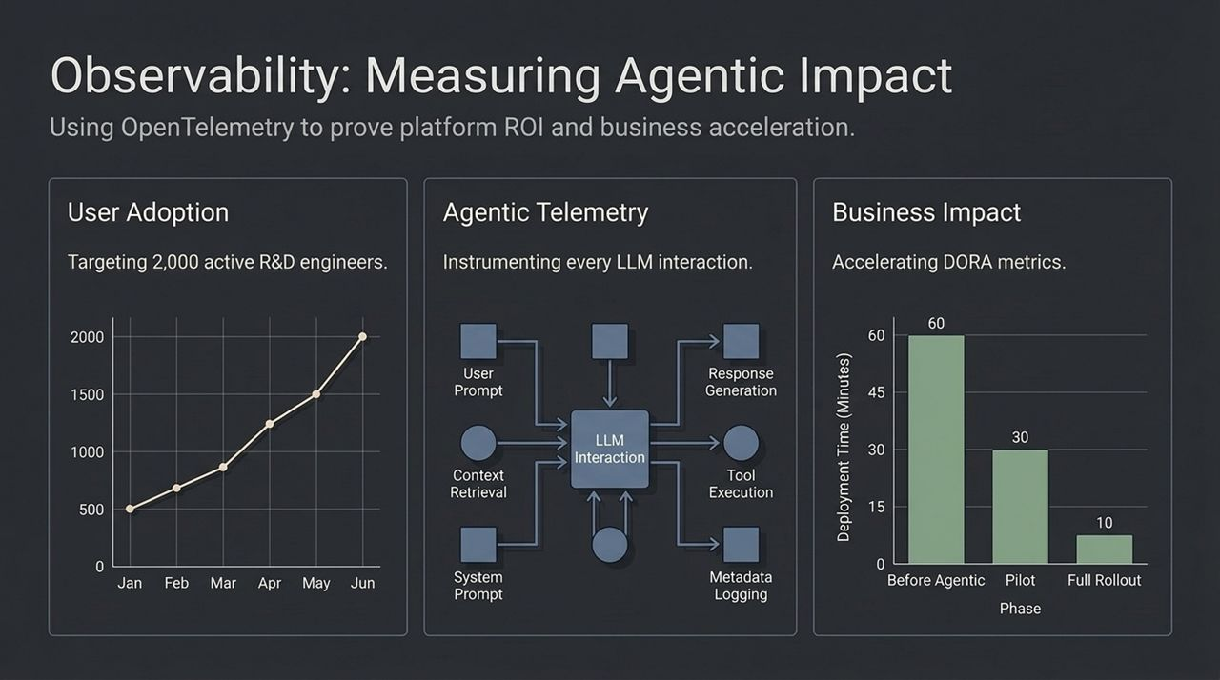
Notes:
Building a great platform is only half the battle; ensuring adoption requires treated internal developer platforms as real products.
If engineers don't know a platform capability or skill exists, they will waste time rebuilding a duplicate solution.
This is why Dynatrace invested dedicated resources into Internal Developer Relations (DevRel). Internal DevRel serves as the connective hub between the centralized Platform Team and decentralized Engineering Squads:
Broadcasting Roadmaps: Educating teams on platform features and agent capabilities.
Gathering Pain Points: Feeding actual developer friction back into product backlogs.
Curating the Marketplace: Helping squads package and share custom skills across the enterprise.

Slide 10
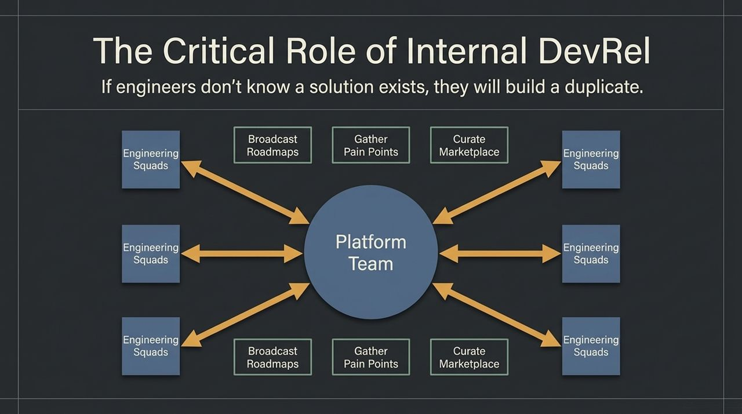
Notes:
To summarize our learnings into an actionable executive strategy, here is our 4-point Blueprint for Scaled AI Engineering:
Build the Brain First: Prioritize a clean, curated software catalog and knowledge graph before trying to connect complex LLM plugins.
Enforce Deterministic Quality: Rely on strict APIs, schemas, and scorecards for production deployment gates—never leave production gates to LLM probability.
Adopt a Product Mindset: Treat your Internal Developer Platform as a product and support it with active Internal DevRel.
Instrument Everything: Apply OpenTelemetry across all agentic interactions to quantify business ROI and DORA acceleration.

Slide 11
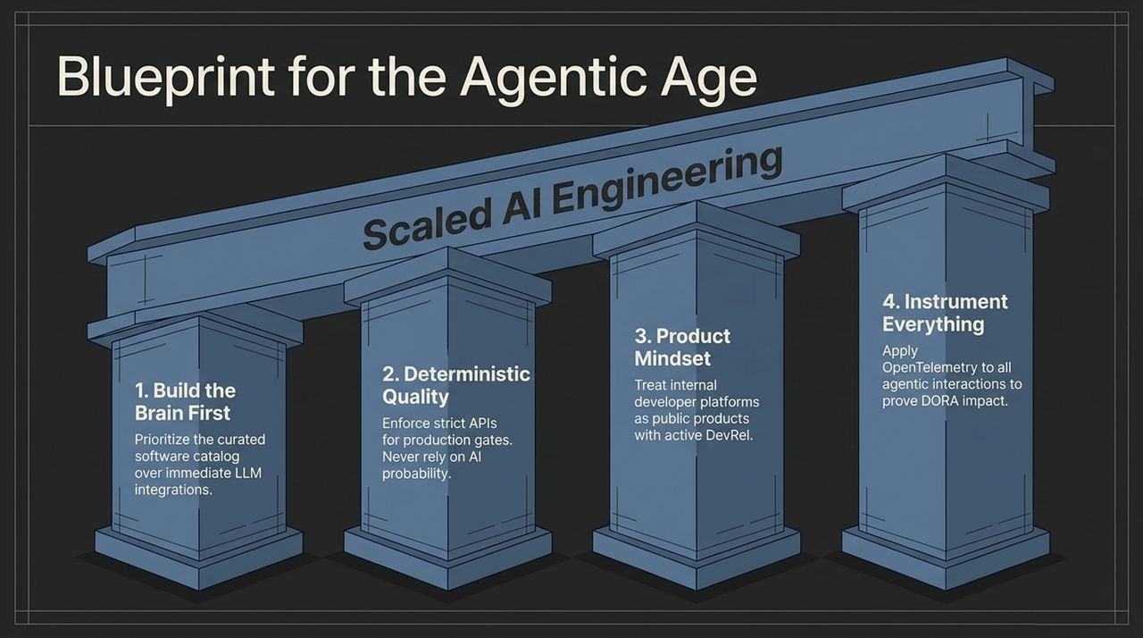
Notes:
As AI agents handle routine tactical tasks—such as boilerplate creation, unit test writing, and bug patches—the role of the human software engineer undergoes a fundamental transformation.
AI handles the 'What', but it cannot independently manage the 'Why'.
Without strategic human direction, agent-generated code rapidly suffers from Software Entropy—a state of unstructured chaos where code is produced quickly but becomes unmaintainable over time.
Engineers must shift from tactical typists to strategic platform architects and gardeners.

Slide 12
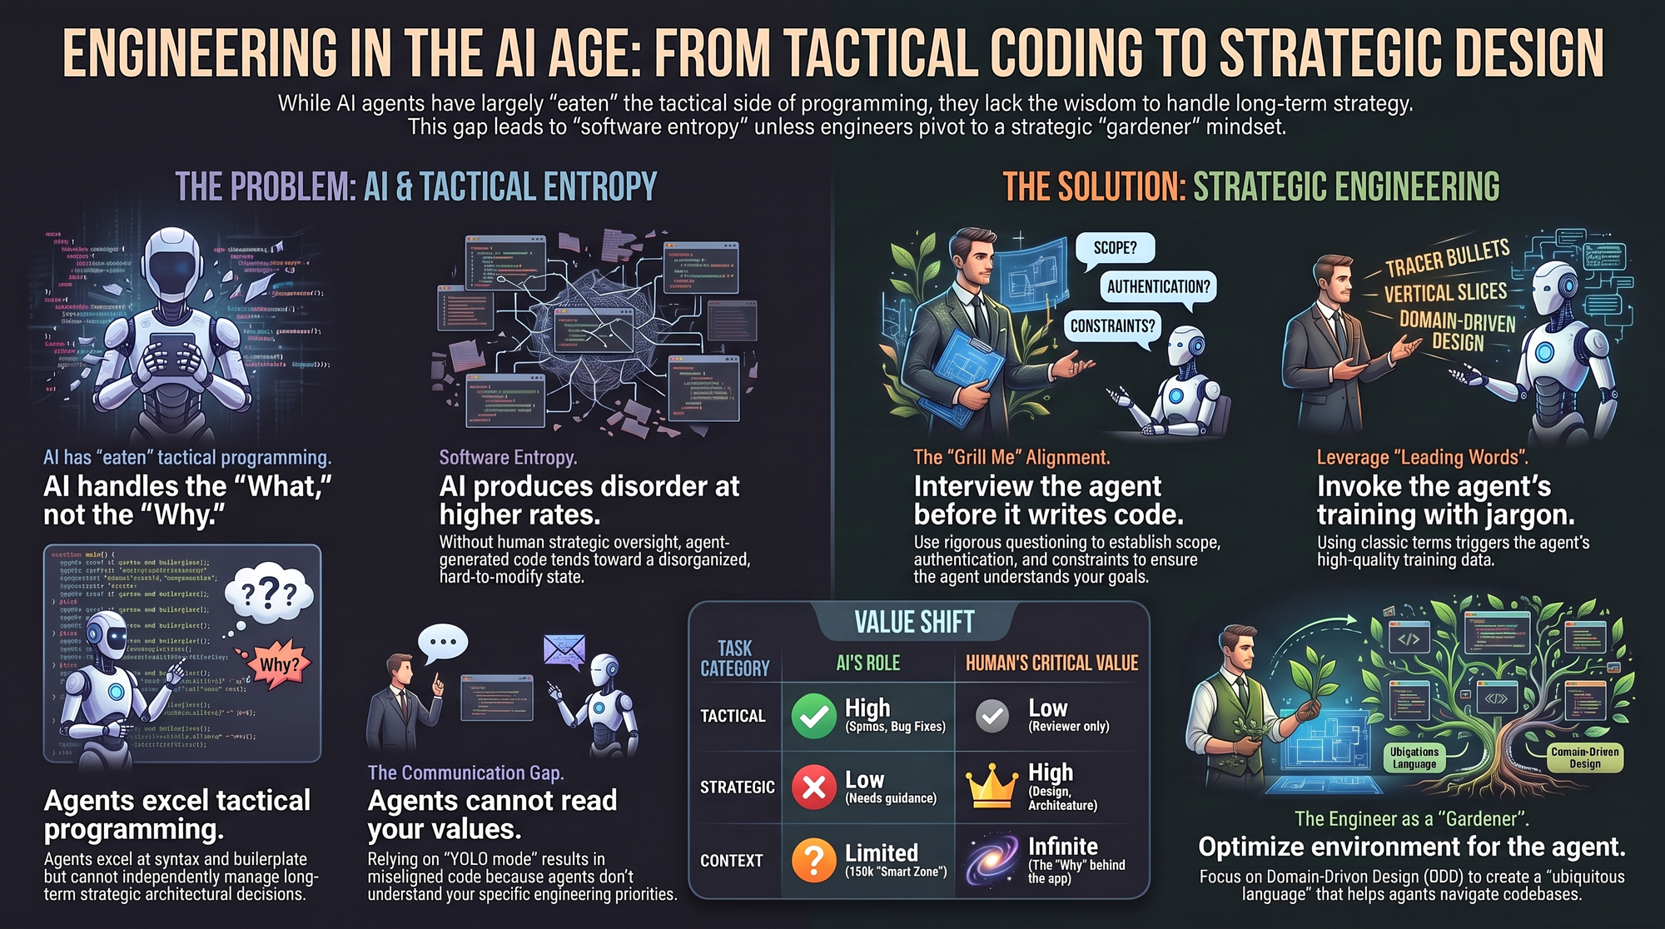
Notes:
To prevent software entropy and align AI agents with enterprise standards, engineers must embrace the Gardener Mindset:
The 'Grill Me' Alignment: Before letting an agent write code, force it to interview you. Instruct the agent to question scope, authentication, and architectural constraints.
Leverage Leading Words: Use domain jargon and standard patterns (e.g., Tracer Bullets, Vertical Slices) to trigger high-quality latent spaces in the LLM’s training data.
Ubiquitous Language & DDD: Apply Domain-Driven Design so that human terminology, code structures, and platform APIs share a unified, explicit language that agents can seamlessly navigate.
https://www.youtube.com/watch?v=3jT_iUHvf_M

